Slide 1
Image segmentation using machine learning classifier

Slide 2
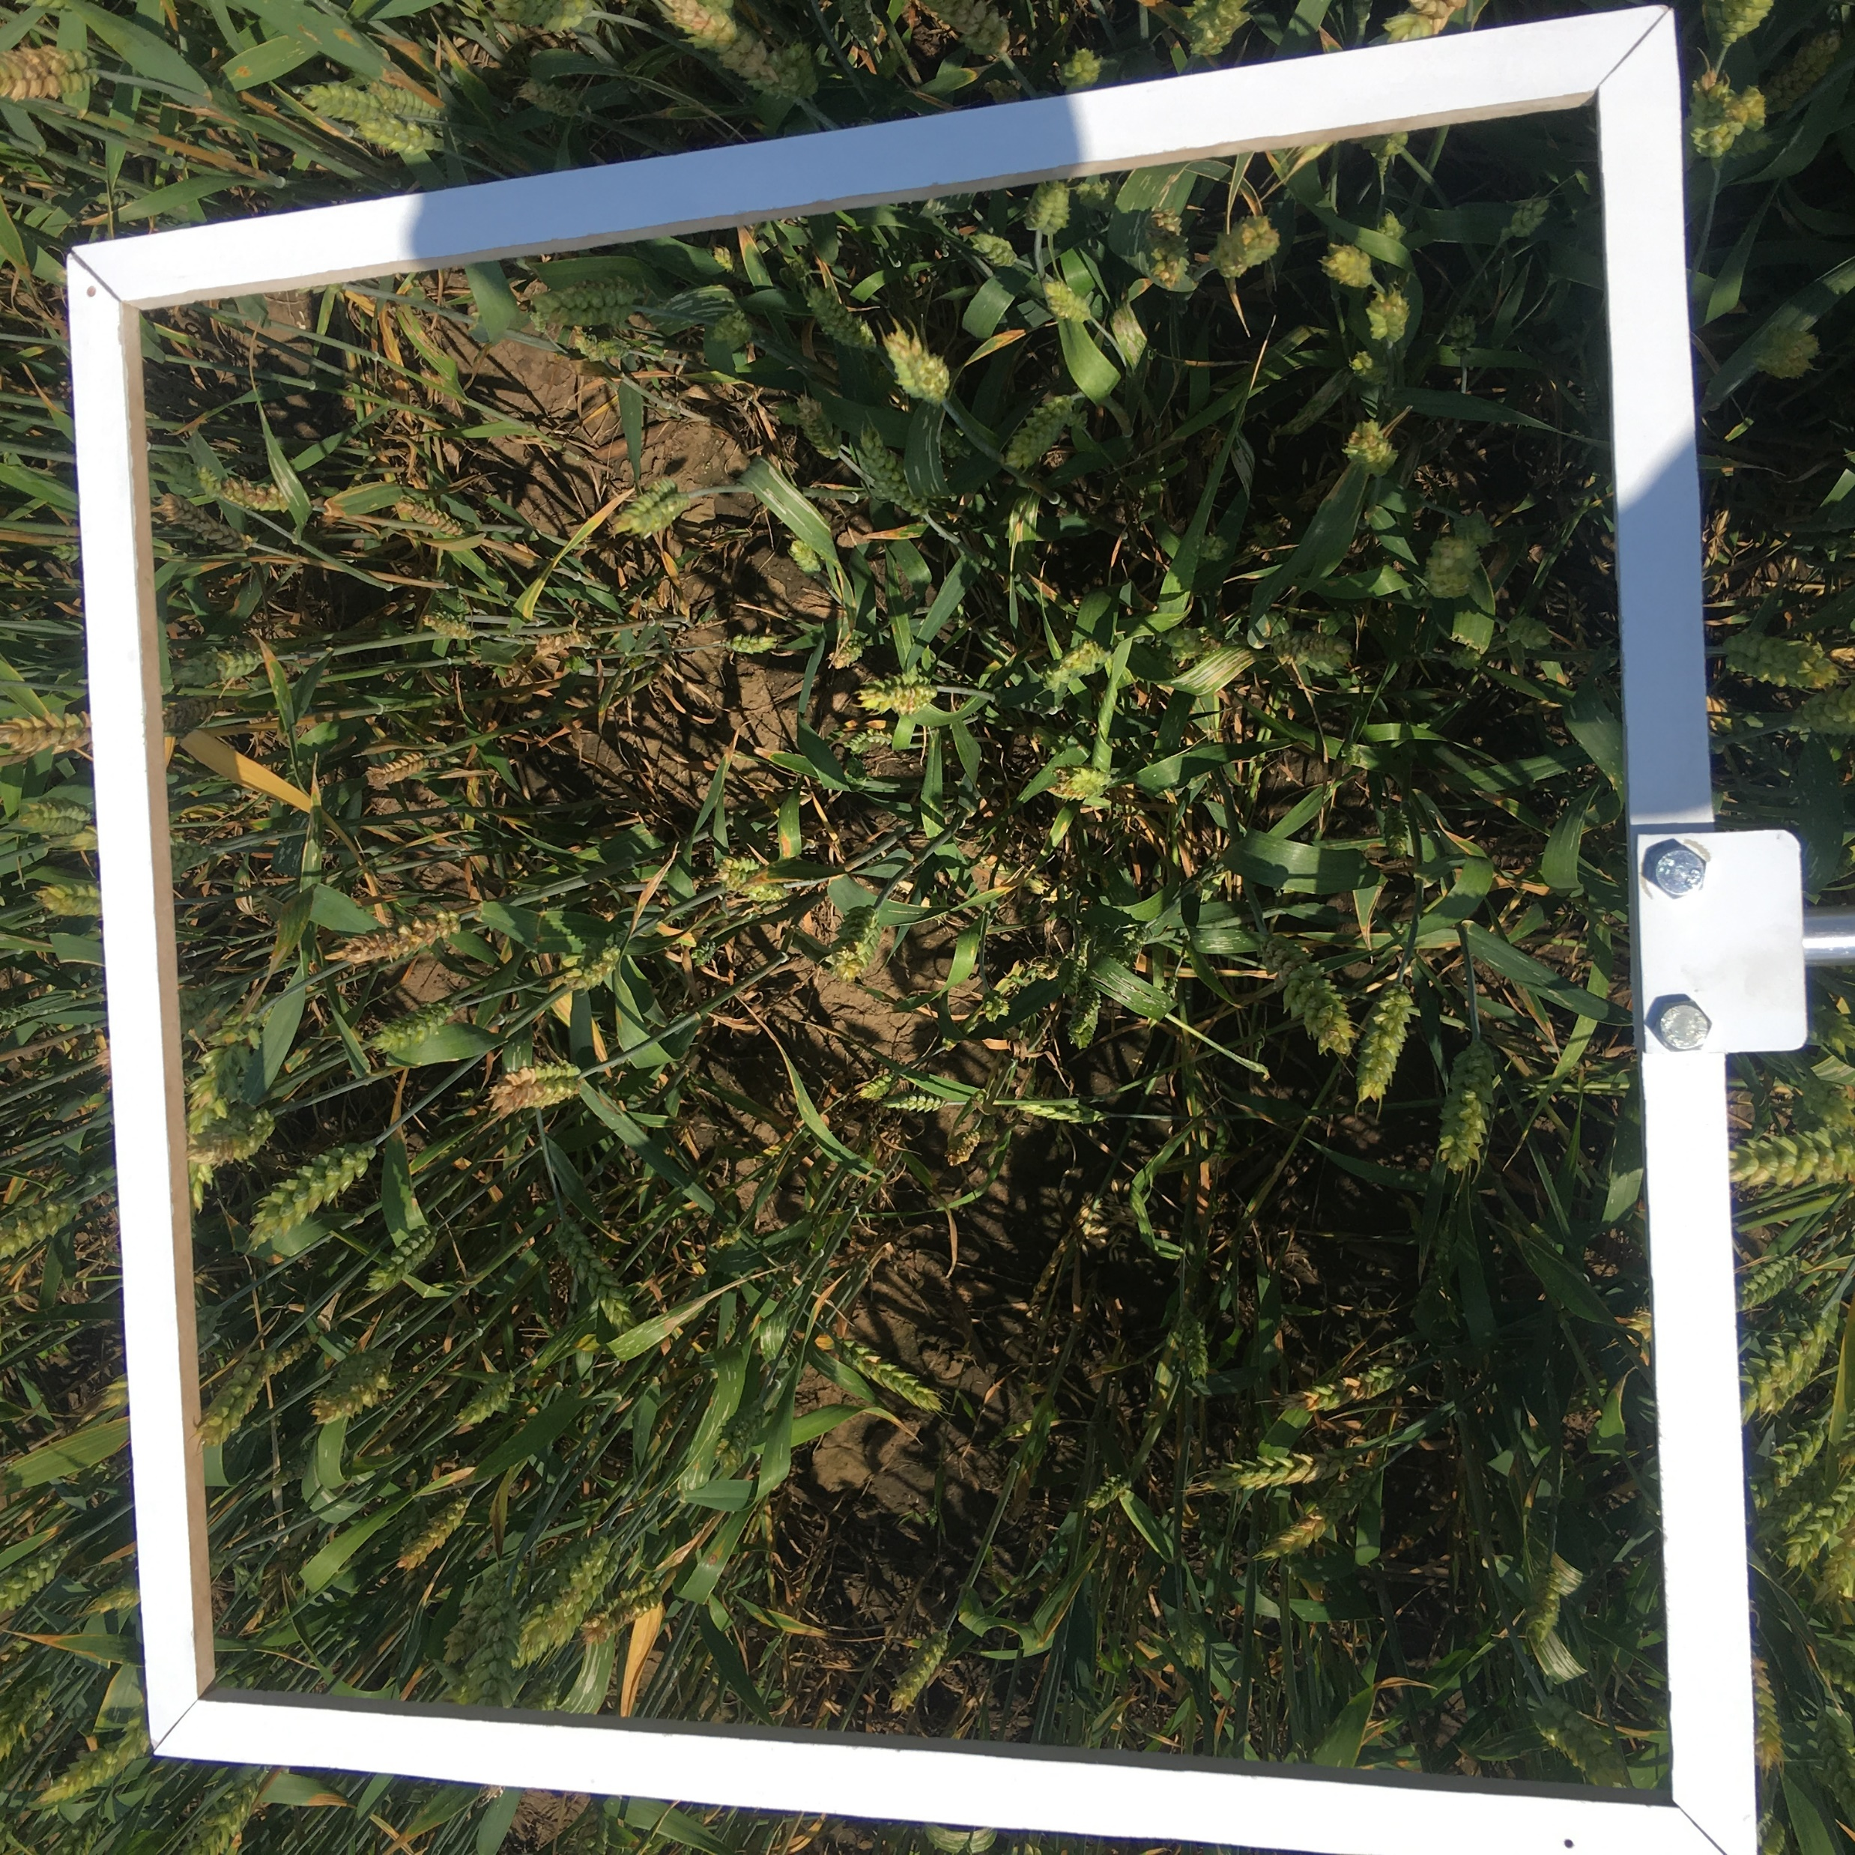
What is our goal?
Original image
Image dimensions: 3024x3024 pixels
Number of images in dataset: 64
Color representation: sRGB
TASK:
SEGMENT IMAGES
MARK WHEAT CLASSES
INSIDE THE WHITE FRAME ONLY
USING ML ALGORITHM

Slide 3


Labels(masks)
ORIGINAL IMAGE
IMAGE WITH LABELS
LABELS

Slide 4
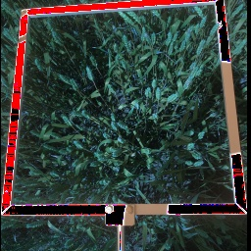
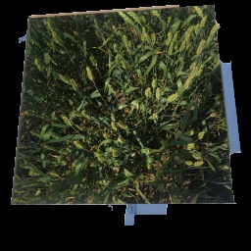
Preprocessing
Resized images from 3024x3024 to 256x256 pixels
Cutting with rectangle
Cutting with cv2.grabcut

Slide 5
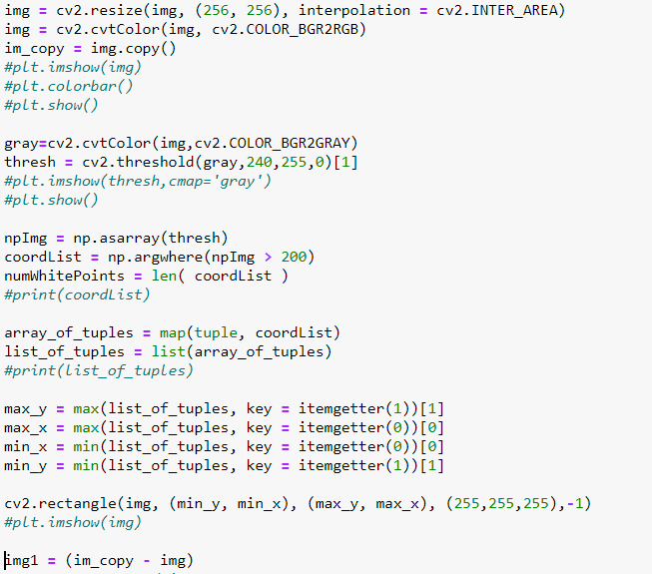
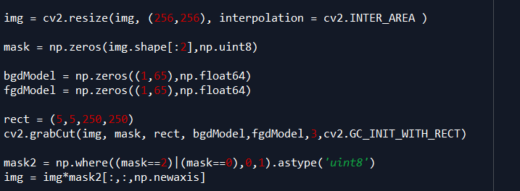
PREPROCESSING:
WITH RECTANGLE
WITH OPENCV GRABCUT

Slide 6
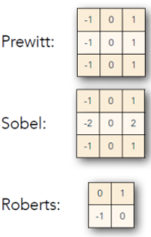
Features
GABOR: A Gabor filter can be viewed as a sinusoidal signal of particular frequency and orientation, modulated by a Gaussian wave.
GAUSSIAN with sigma 3 and 7
MEDIAN with sigma = 3: The median filter is a non-linear digital filtering technique, often used to remove noise from an image or signal.
FOR EDGE DETECTION:
CANNY EDGE: The Canny edge detector is an edge detection operator that uses a multi-stage algorithm to detect a wide range of edges in images.
ROBERTS EDGE
PREWITT
SOBEL
Kernels:

Slide 7

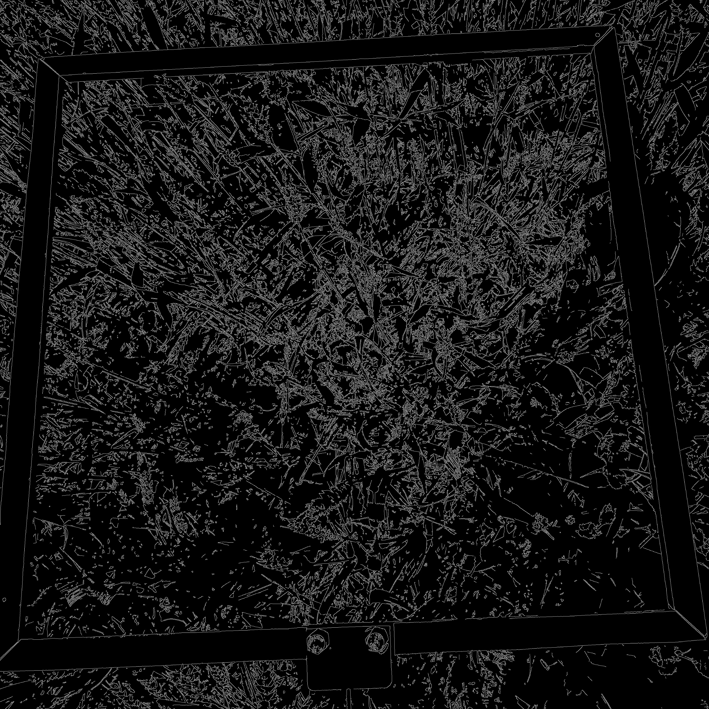
FEATURES
ORIGINAL IMAGE
SOBEL
MEDIAN
SCHARR
GAUSS, SIGMA = 3
GAUSS, SIGMA = 7
PREWITT
CANNY EDGE

Slide 8
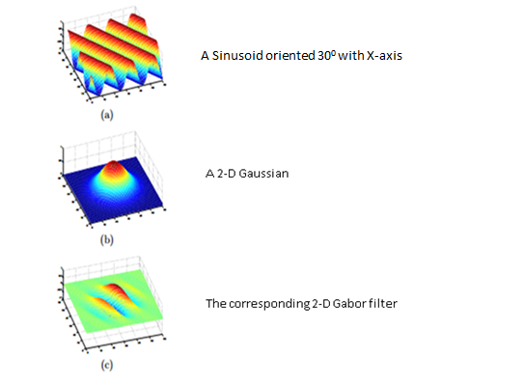
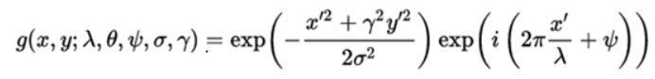
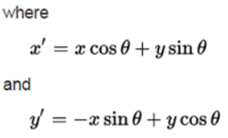
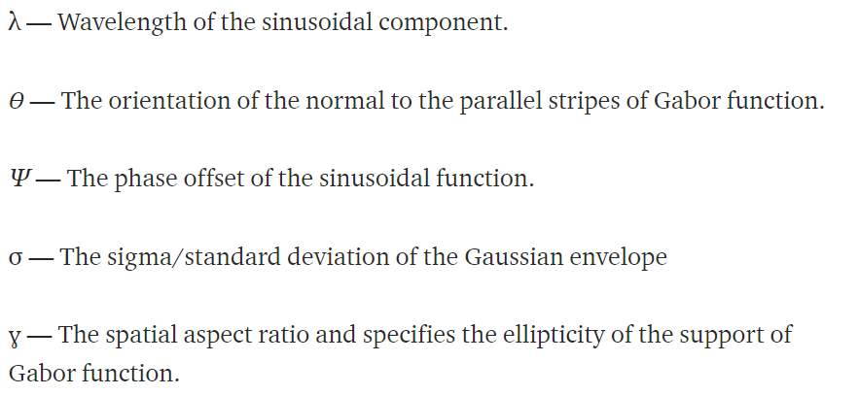
FEATURES: GABOR
A 2-D Gabor filter obtained by modulating the sine wave with a Gaussian.

Slide 9
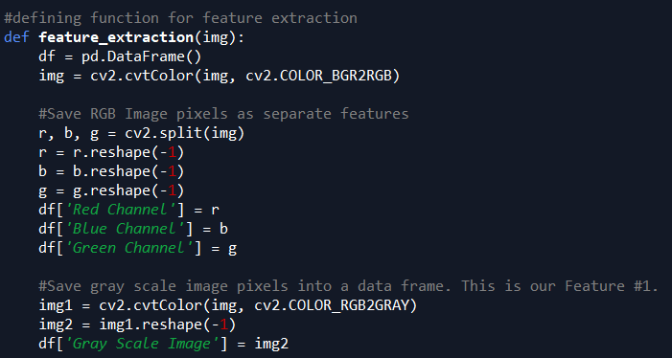
FEATURE EXTRACTION FUNCTION

Slide 10
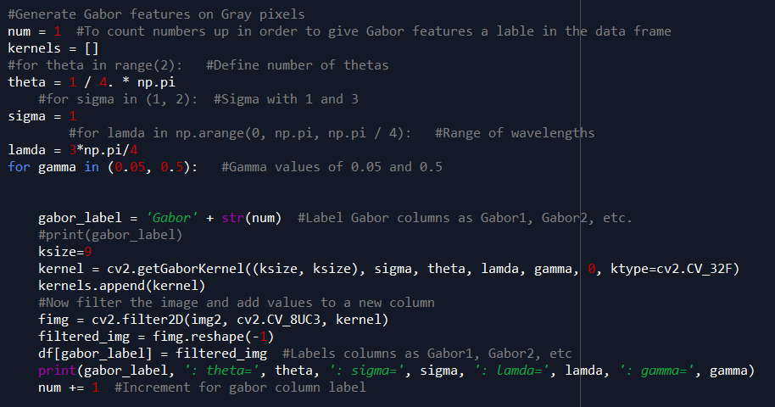
FEATURE EXTRACTION FUNCTION

Slide 11
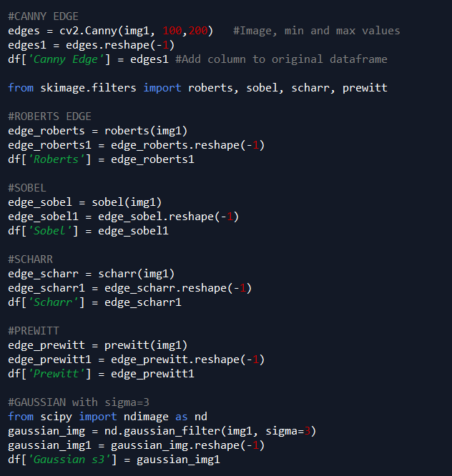
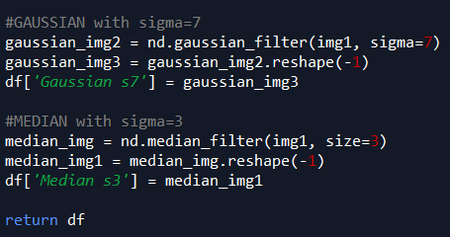
FEATURE EXTRACTION FUNCTION

Slide 12
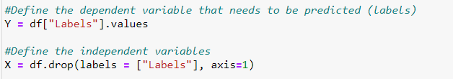
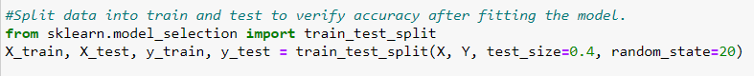
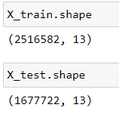
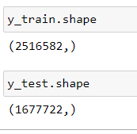
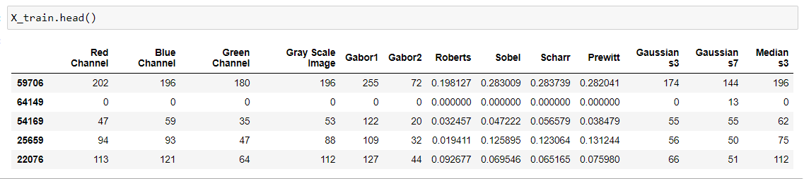
Features

Slide 13
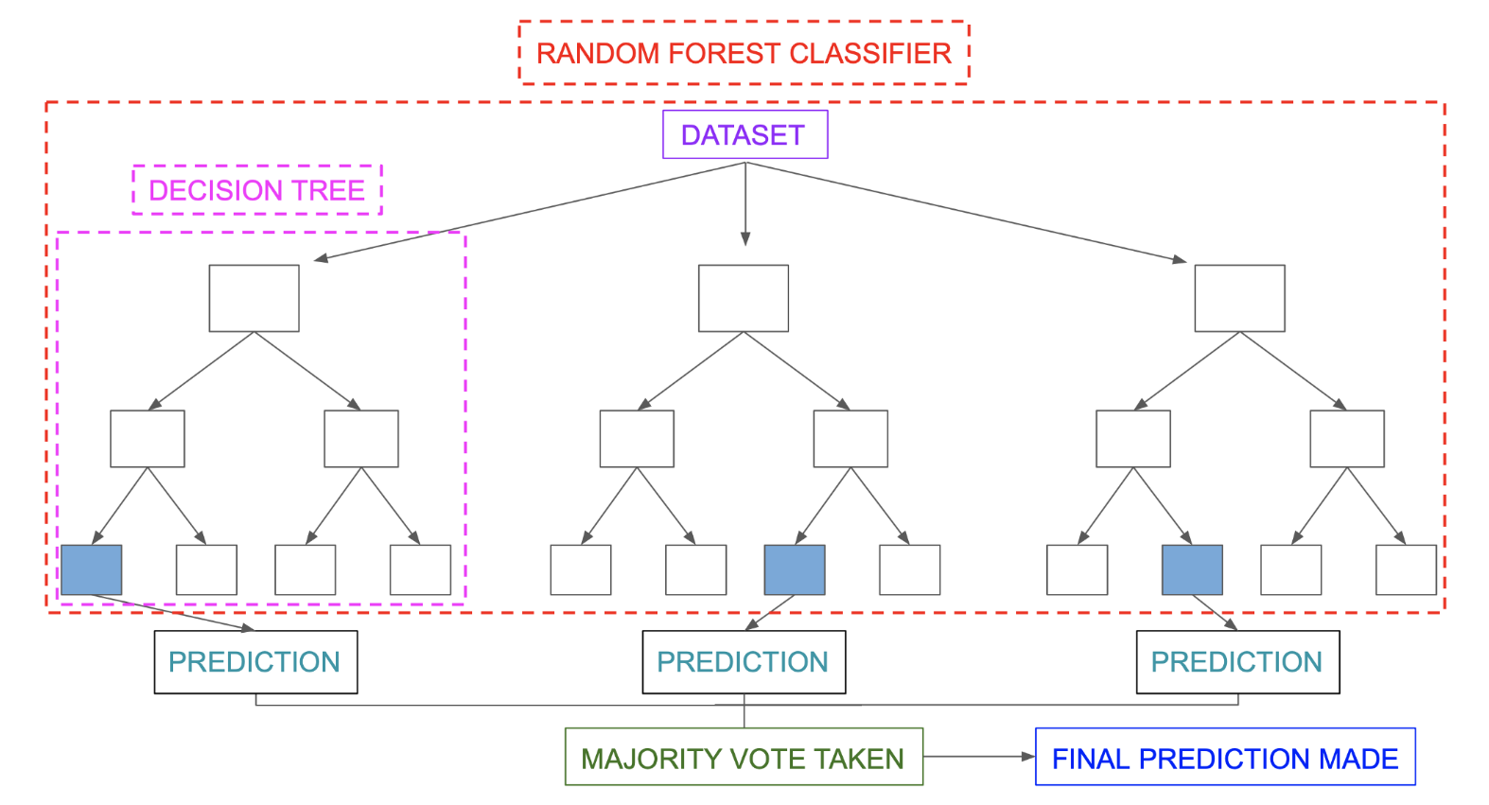
Classifier
Random forest:
Num of trees(estimators): 100
Number of features: 48
Min samples leaf = 1
Min samples split = 2

Slide 14
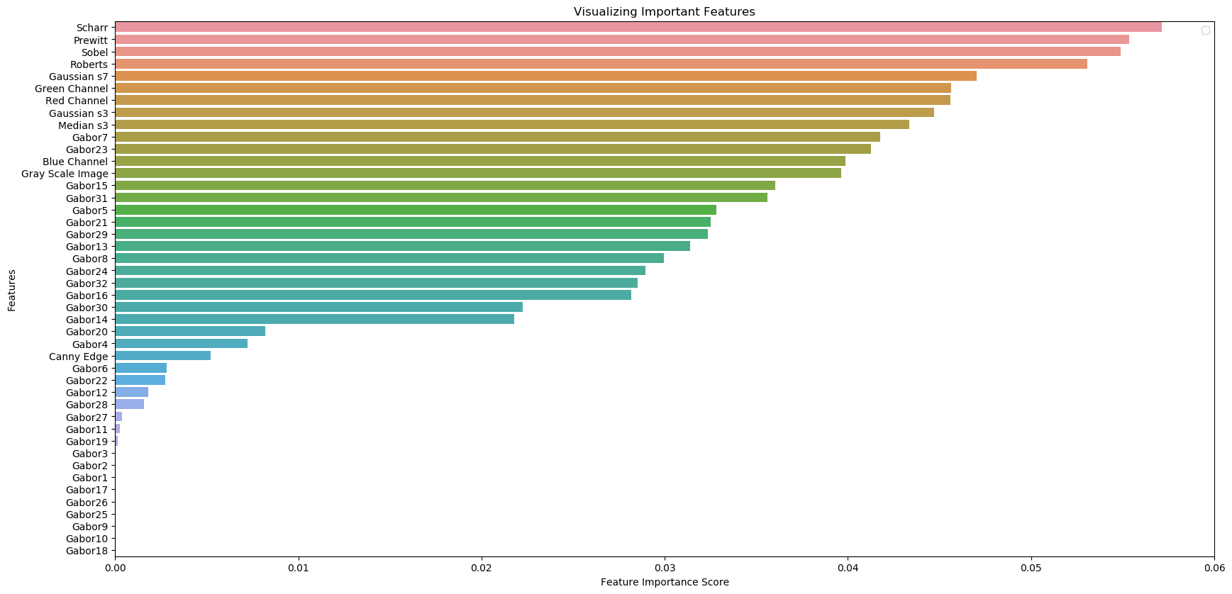
Feature importance

Slide 15
Feature importance
FEATURES: IMPORTANCE:
Scharr 0.057151
Prewitt 0.055370
Sobel 0.054894
Roberts 0.053072
Gaussian s7 0.047027
Green Channel 0.045627
Red Channel 0.045605
Gaussian s3 0.044712
Median s3 0.043334
Gabor7 0.041752
Gabor23 0.041275
Blue Channel 0.039854
Gray Scale Image 0.039634
Gabor15 0.036022
Gabor31 0.035610
Gabor5 0.032817
FEATURES: IMPORTANCE:
Gabor21 0.032508
Gabor29 0.032346
Gabor13 0.031382
Gabor8 0.029948
Gabor24 0.028951
Gabor32 0.028523
Gabor16 0.028157
Gabor30 0.022245
Gabor14 0.021787
Gabor20 0.008195
Gabor4 0.007243
Canny Edge 0.005219
Gabor6 0.002817
Gabor22 0.002755
Gabor12 0.001822
Gabor28 0.001586
FEATURES: IMPORTANCE:
Gabor27 0.000362
Gabor11 0.000243
Gabor19 0.000153
Gabor3 0.000003
Gabor2 0.000000
Gabor1 0.000000
Gabor17 0.000000
Gabor26 0.000000
Gabor25 0.000000
Gabor9 0.000000
Gabor10 0.000000
Gabor18 0.000000

Slide 16
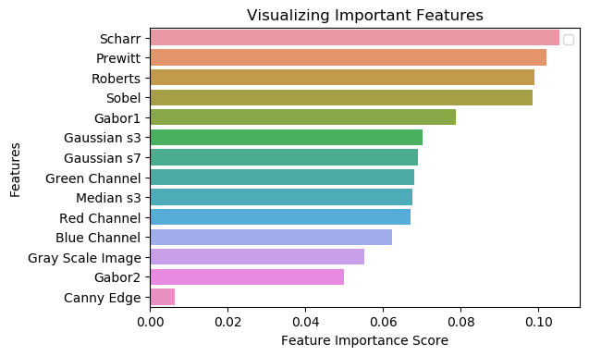
Feature importance

Slide 17
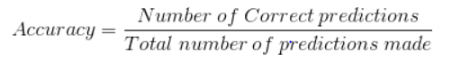
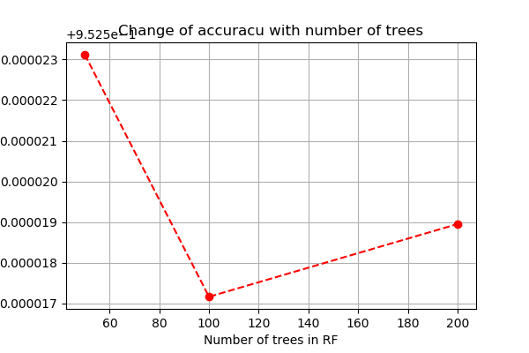
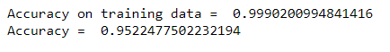
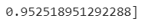
Accuracy
For number of estimators = 50:
For number of estimators = 100:
For number of estimators = 200:

Slide 18
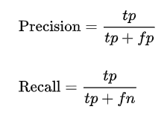
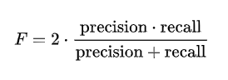
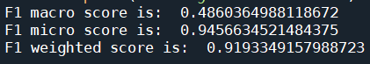
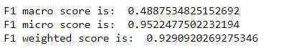
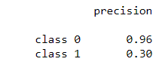
F1 SCORE
Precision is the fraction of relevant instances among the retrieved instances, while recall is the fraction of the total amount of relevant instances that were actually retrieved.
F1 SCORE:
MICRO: Calculate metrics globally by counting the total true positives, false negatives and false positives.
MACRO: Calculate metrics for each label, and find their unweighted mean. This does not take label imbalance into account.
WEIGHTED: Calculate metrics for each label, and find their average weighted by support (the number of true instances for each label). This alters ‘macro’ to account for label imbalance; it can result in an F-score that is not between precision and recall.
For number of estimators = 50:
For number of estimators = 100:

Slide 19
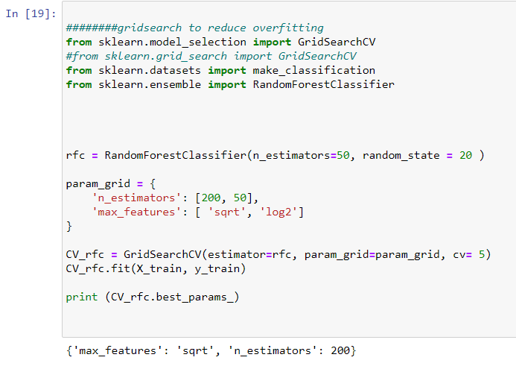
Gridsearch

Slide 20
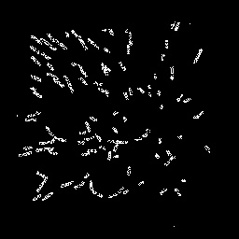
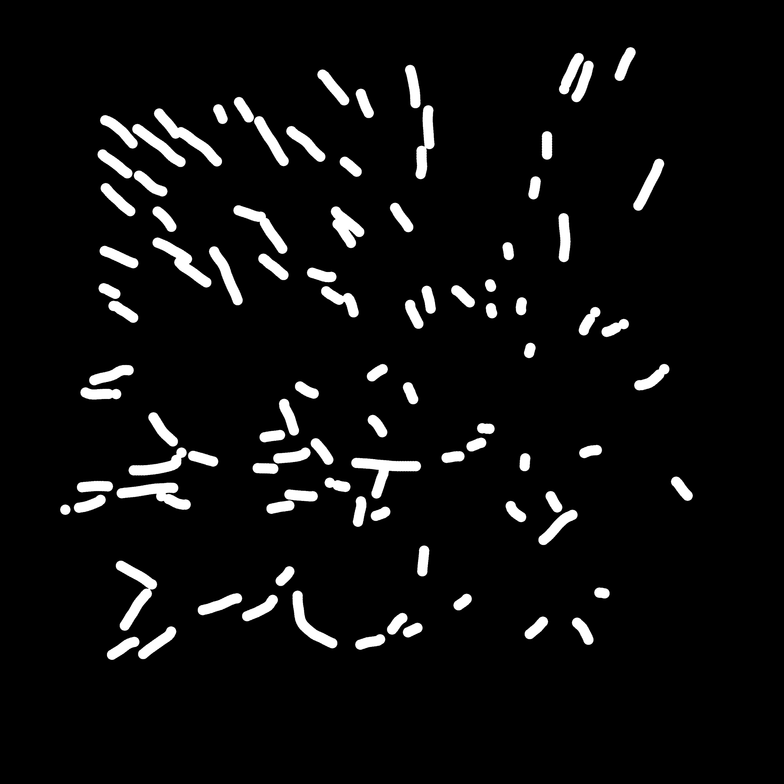
Results
SEGMENTED MASK
ORIGINAL MASK

Slide 21
Results for our model
Packages used:
os
operator
glob
sklearn
seaborn
Pickle
numpy
random
opencv
matplotlib
pandas
RF Classifier
Estimators 200
Features 14
Accuracy 0.945
F1 score 0.94
USED:
JUPYTER NOTEBOOK
COLAB
SPYDER

Slide 22
THANK YOU FOR YOUR ATTENTION!
STUDENTS: KATARINA TODOROVIĆ
MARIJA JOVANOVIĆ

